Slide 1
Solving large linear system of equations by HHL Algorithm
20/2/2021

Slide 2
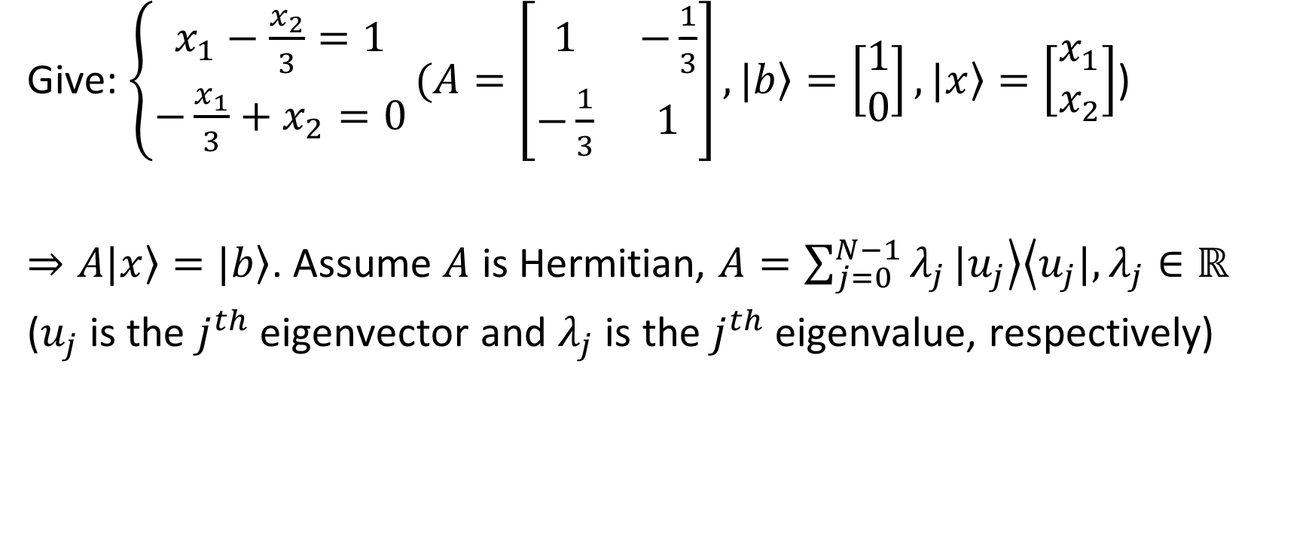
1. Introduction
Give: $\left\{\begin{aligned}x_{1}−\frac{x_{2}}{3}=1 \\ −\frac{x_{1}}{3}+x_{2}=0\end{aligned}\right.(A=\left[\begin{matrix}1 & −\frac{1}{3} \\ −\frac{1}{3} & 1\end{matrix}\right], \left.|b\right\rangle =\left[\begin{matrix}1 \\ 0\end{matrix}\right],\left.|x\right\rangle =\left[\begin{matrix}x_{1} \\ x_{2}\end{matrix}\right]$)
$⇒A\left.|x\right\rangle =\left.|b\right\rangle$. Assume $A$ is Hermitian, $A=\sum_{j=0}^{N−1}{λ_{j}}\left.|u_{j}\right\rangle \left\langle u_{j}|\right., λ_{j}∈ℝ$
($u_{j}$ is the $j^{th}$ eigenvector and $λ_{j}$ is the $j^{th}$ eigenvalue, respectively)

Slide 3
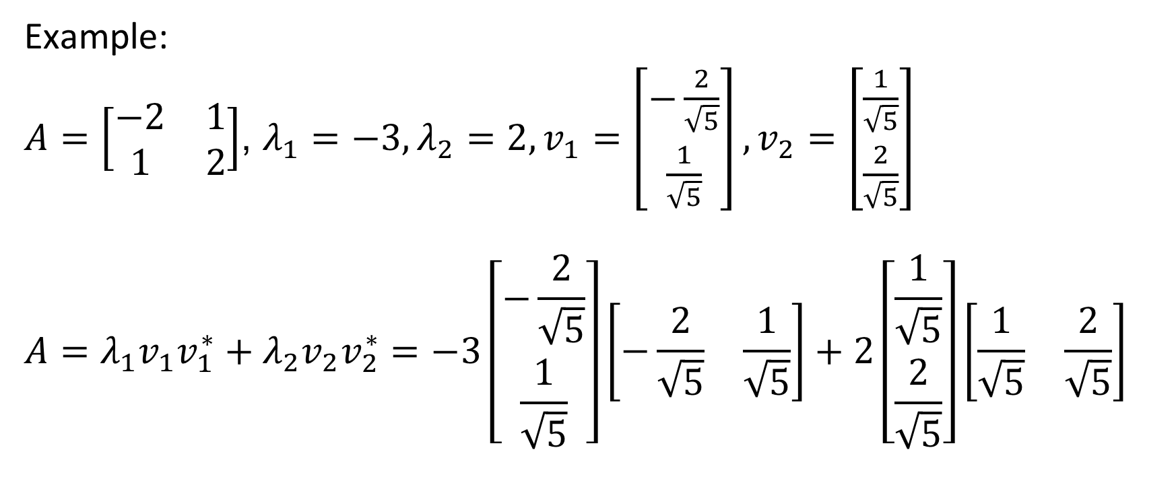
1. Introduction
Example:
$A=\left[\begin{matrix}−2 & 1 \\ 1 & 2\end{matrix}\right]$, $λ_{1}=−3,λ_{2}=2,v_{1}=\left[\begin{matrix}−\frac{2}{\sqrt{5}} \\ \frac{1}{\sqrt{5}}\end{matrix}\right],v_{2}=\left[\begin{matrix}\frac{1}{\sqrt{5}} \\ \frac{2}{\sqrt{5}}\end{matrix}\right]$
$$A=λ_{1}v_{1}v_{1}^{∗}+λ_{2}v_{2}v_{2}^{∗}=−3\left[\begin{matrix}−\frac{2}{\sqrt{5}} \\ \frac{1}{\sqrt{5}}\end{matrix}\right]\left[\begin{matrix}−\frac{2}{\sqrt{5}} & \frac{1}{\sqrt{5}}\end{matrix}\right]+2\left[\begin{matrix}\frac{1}{\sqrt{5}} \\ \frac{2}{\sqrt{5}}\end{matrix}\right]\left[\begin{matrix}\frac{1}{\sqrt{5}} & \frac{2}{\sqrt{5}}\end{matrix}\right]$$

Slide 4

1. Introduction
Then:
$$A^{−1}=\sum_{j=0}^{N−1}{λ_{j}^{−1}}\left.|u_{j}\right\rangle \left\langle u_{j}|\right.$$
$$\left.|b\right\rangle =\sum_{j=0}^{N−1}{b_{j}}\left.|u_{j}\right\rangle$$
$$⇒\left.|x\right\rangle =A^{−1}\left.|b\right\rangle =\sum_{j=0}^{N−1}{{λ_{j}^{−1}b}_{j}}\left.|u_{j}\right\rangle$$

Slide 5
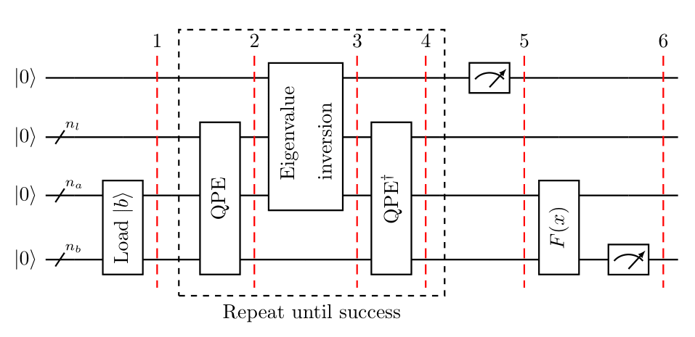

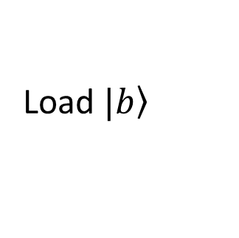
2. HHL Algorithm
Load eigenvalue of $A$
Ancilla bit
Load $\left.|b\right\rangle$

Slide 6
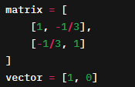
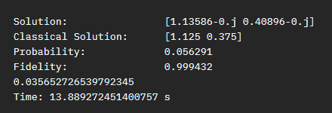
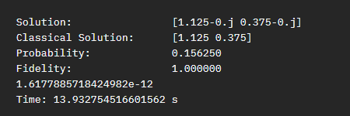
3. Run on qiskit
Approximate t
Norm 2 between 2 solutions
Exactly t

Slide 7
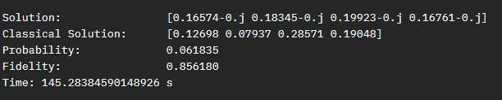
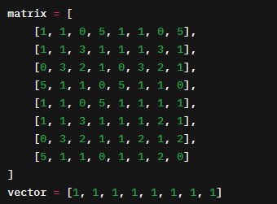
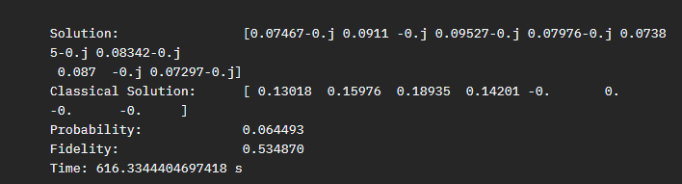
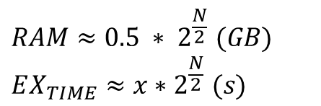
1. 3 GB RAM
3.9 GB RAM
$$RAM≈0.5 ∗ 2^{\frac{N}{2}} (GB)$$
$$EX_{TIME}≈x∗2^{\frac{N}{2}} (s)$$

Slide 8

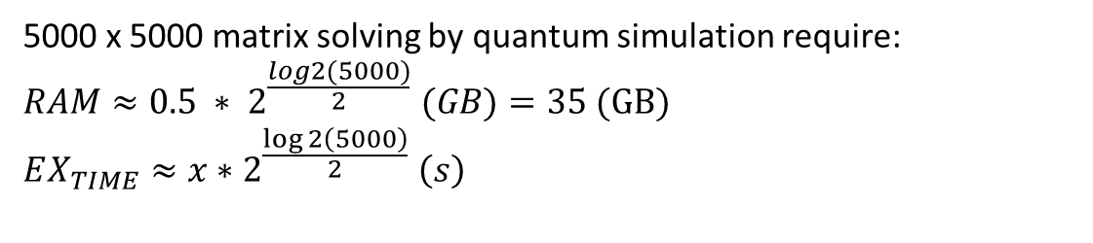
5000 x 5000 matrix solving by classical computer
5000 x 5000 matrix solving by quantum simulation require:
$$RAM≈0.5 ∗ 2^{\frac{log2(5000)}{2}} (GB)=35 (GB)$$
$$EX_{TIME}≈x∗2^{\frac{\log{2\left(5000\right)}}{2}} \left(s\right)$$

Slide 9

Global phase & relative phase
Consider state $\left.|φ\right\rangle =c_{1}\left.|0\right\rangle +c_{2}\left.|1\right\rangle =r_{1}e^{iφ_{1}}\left.|0\right\rangle +r_{2}e^{iφ_{2}}\left.|1\right\rangle$
$$=e^{iφ_{1}}(\left.r_{1}|0\right\rangle +r_{2}e^{i\left(φ_{2}−φ_{1}\right)}\left.|1\right\rangle )$$
$e^{iφ_{1}}$ is vanish while conduct the measurement ${|\left\langle φ | φ\right\rangle |}^{2}$

Slide 10
Summary HHL
Quantum phase estimation (QPE)
Phase kickback
Quantum Fourier transform (QFT)
Inverse of QPE

Slide 11
1. What is Phase kickback?

Slide 12
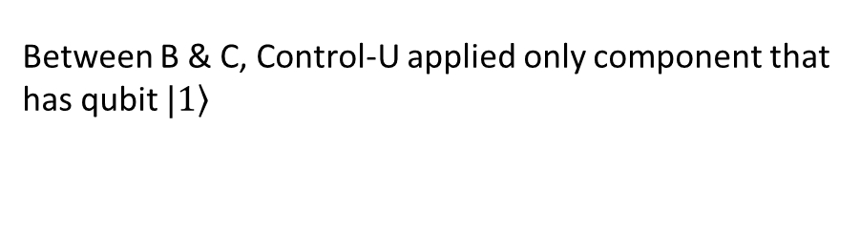
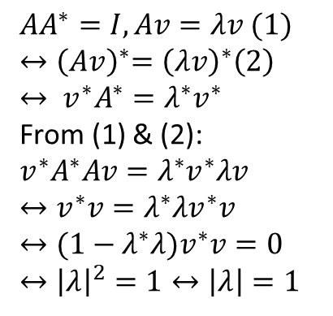
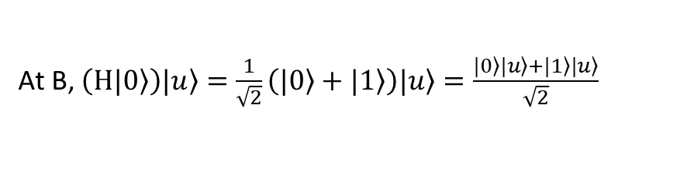
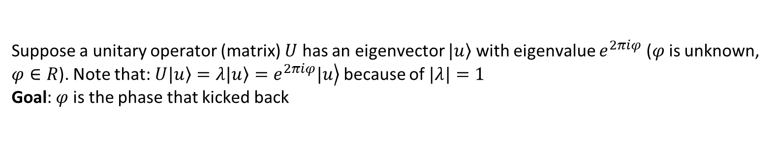
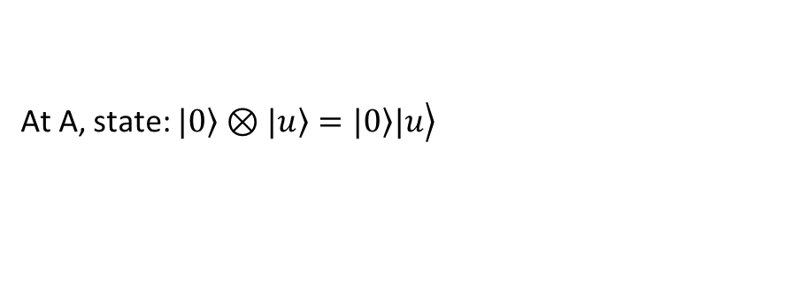
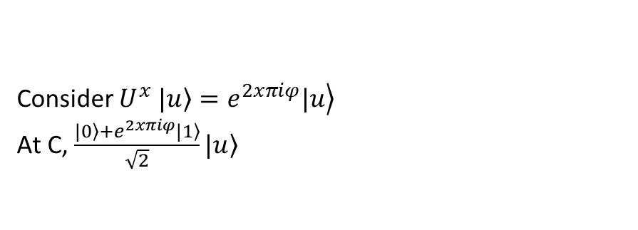
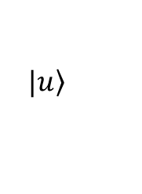
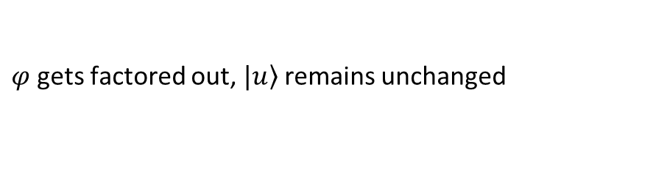
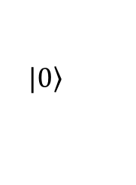
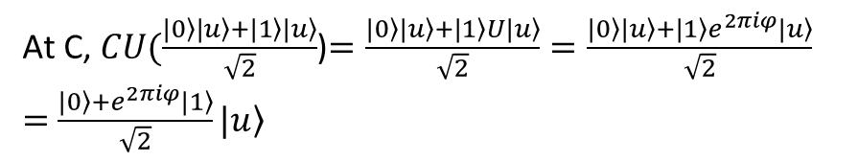
Suppose a unitary operator (matrix) $U$ has an eigenvector $\left.|u\right\rangle$ with eigenvalue $e^{2πiφ}$ ($φ$ is unknown, $φ∈R$). Note that: $U\left.|u\right\rangle =λ\left.|u\right\rangle =\left.e^{2πiφ}|u\right\rangle$ because of $|λ|=1$
Goal: $φ$ is the phase that kicked back
$$AA^{∗}=I, Av=λv (1)$$
$${↔\left(Av\right)}^{∗}={\left(λv\right)}^{∗}\left(2\right)$$
$$↔ {v^{∗}A}^{∗}=λ^{∗}v^{∗}$$
From (1) & (2):
$${v^{∗}A}^{∗}Av=λ^{∗}v^{∗}λv$$
$$↔v^{∗}v=λ^{∗}λv^{∗}v$$
$$↔(1−λ^{∗}λ)v^{∗}v=0$$
$$↔{\left|λ\right|}^{2}=1↔\left|λ\right|=1$$
$$\left.|0\right\rangle$$
H
control
M
$$\left.|u\right\rangle$$
U
target
A
B
C
At A, state: $\left.|0\right\rangle ⊗\left.|u\right\rangle =\left.\left.|0\right\rangle |u\right\rangle$
Consider $U^{x}$ $\left.|u\right\rangle =\left.e^{2xπiφ}|u\right\rangle$
At C, $\frac{\left.|0\right\rangle +e^{2xπiφ}\left.|1\right\rangle }{\sqrt{2}}\left.|u\right\rangle$
At B, $\left(H\left.|0\right\rangle \right)\left.|u\right\rangle =\frac{1}{\sqrt{2}}\left(\left.|0\right\rangle +\left.|1\right\rangle \right)\left.|u\right\rangle =\frac{\left.|0\right\rangle \left.|u\right\rangle +\left.|1\right\rangle \left.|u\right\rangle }{\sqrt{2}}$
Between B & C, Control-U applied only component that has qubit $\left.|1\right\rangle$
At C, $CU(\frac{\left.|0\right\rangle \left.|u\right\rangle +\left.|1\right\rangle \left.|u\right\rangle }{\sqrt{2}}$)$=\frac{\left.|0\right\rangle \left.|u\right\rangle +\left.|1\right\rangle U\left.|u\right\rangle }{\sqrt{2}}=\frac{\left.|0\right\rangle \left.|u\right\rangle +\left.|1\right\rangle e^{2πiφ}\left.|u\right\rangle }{\sqrt{2}}$
$=$ $\frac{\left.|0\right\rangle +e^{2πiφ}\left.|1\right\rangle }{\sqrt{2}}\left.|u\right\rangle$
$φ$ gets factored out, $\left.|u\right\rangle$ remains unchanged

Slide 13
2. Quantum Fourier Transform

Slide 14
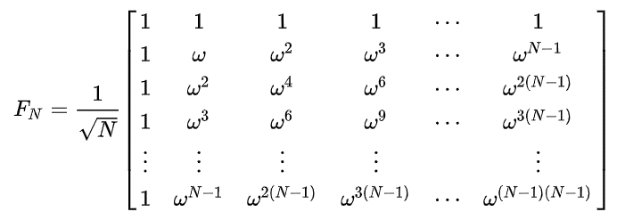
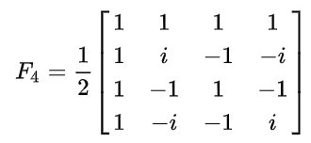
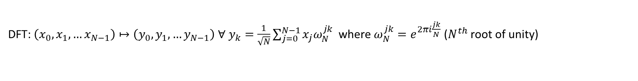

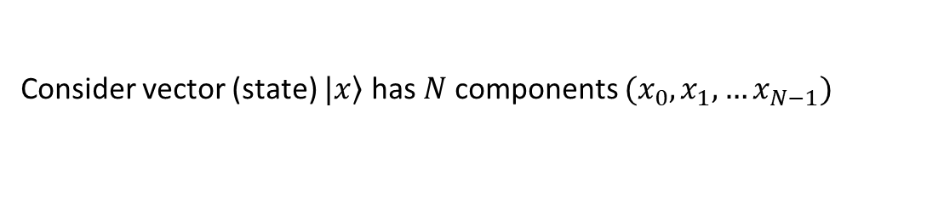
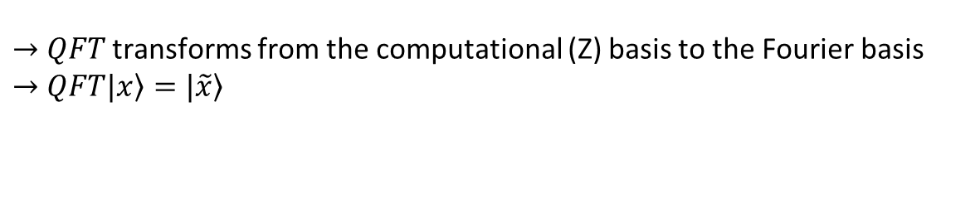
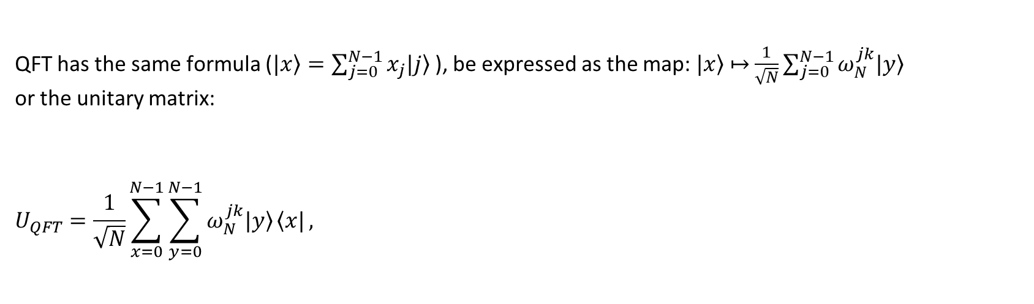
Consider vector (state) $\left.|x\right\rangle$ has $N$ components $(x_{0},x_{1},…x_{N−1})$
DFT: $\left(x_{0},x_{1},…x_{N−1}\right)↦\left(y_{0},y_{1},…y_{N−1}\right) ∀ y_{k}=\frac{1}{\sqrt{N}}\sum_{j=0}^{N−1}{x_{j}ω_{N}^{jk} }$ where $ω_{N}^{jk}=e^{2πi\frac{jk}{N}}$ ($N^{th}$ root of unity)
QFT has the same formula ($\left.|x\right\rangle =\sum_{j=0}^{N−1}{x_{j}\left.|j\right\rangle }$), be expressed as the map:$\left.|x\right\rangle$ $↦$ $\frac{1}{\sqrt{N}}\sum_{j=0}^{N−1}{ω_{N}^{jk}\left.|y\right\rangle }$
or the unitary matrix:
$$U_{QFT}=\frac{1}{\sqrt{N}}\sum_{x=0}^{N−1}{\sum_{y=0}^{N−1}{ω_{N}^{jk}\left.|y\right\rangle }\left\langle x|\right.},$$
Example with $N=4, ω=e^{\frac{2πi}{4}}=i$
$→$ $QFT$ transforms from the computational (Z) basis to the Fourier basis
$→$ $QFT\left.|x\right\rangle =\left.|\tilde{x}\right\rangle$

Slide 15
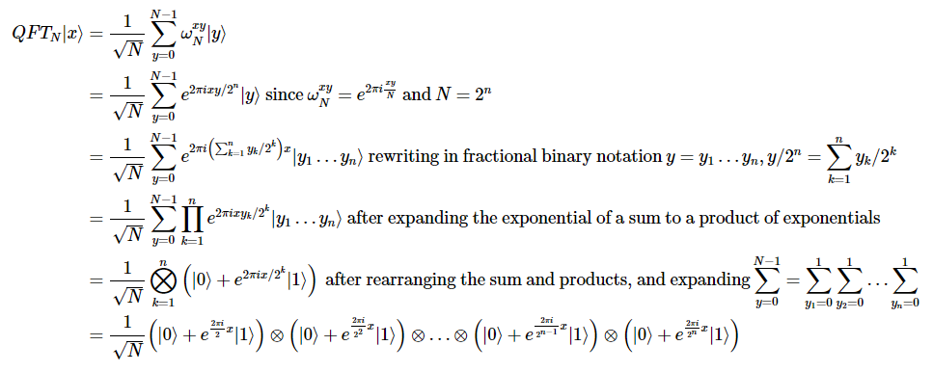

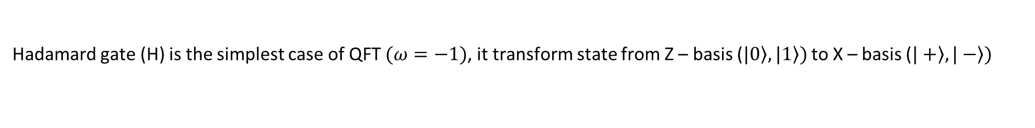
Hadamard gate (H) is the simplest case of QFT $(ω=−1)$, it transform state from Z – basis ($\left.|0\right\rangle ,\left.|1\right\rangle )$ to X – basis ($\left.|+\right\rangle ,\left.|−\right\rangle )$
Consider state $\left.|ψ\right\rangle =α\left.|0\right\rangle +β\left.|1\right\rangle$ ($x_{0}=α, x_{1}=β,N=2)$
$$y_{0}=\frac{1}{\sqrt{2}}\left(αe^{2πi\frac{0x0}{2}}+βe^{2πi\frac{1x0}{2}}\right)=\frac{1}{\sqrt{2}}(α+β)$$
$$y_{1}=\frac{1}{\sqrt{2}}\left(αe^{2πi\frac{0x1}{2}}+βe^{2πi\frac{1x1}{2}}\right)=\frac{1}{\sqrt{2}}(α−β)$$
$$U_{QFT}\left.|ψ\right\rangle =\frac{1}{\sqrt{2}}\left(α+β\right)\left.|0\right\rangle +\frac{1}{\sqrt{2}}\left(α−β\right)\left.|1\right\rangle$$

Slide 16
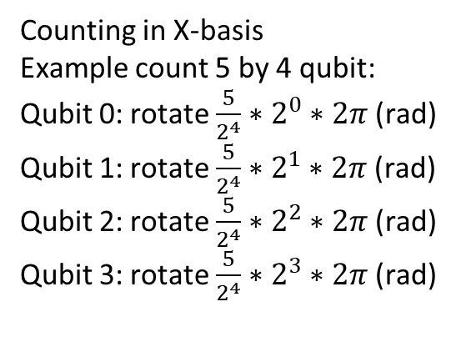
What QFT used for?
Counting in Z-basis seems like to classical computing
Counting in X-basis
Example count 5 by 4 qubit:
Qubit 0: rotate $\frac{5}{2^{4}}∗2^{0}∗2π$ (rad)
Qubit 1: rotate $\frac{5}{2^{4}}∗2^{1}∗2π$ (rad)
Qubit 2: rotate $\frac{5}{2^{4}}∗2^{2}∗2π$ (rad)
Qubit 3: rotate $\frac{5}{2^{4}}∗2^{3}∗2π$ (rad)

Slide 17
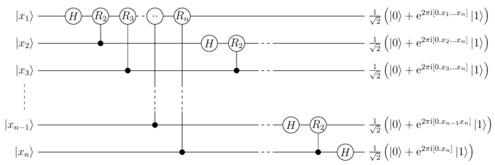
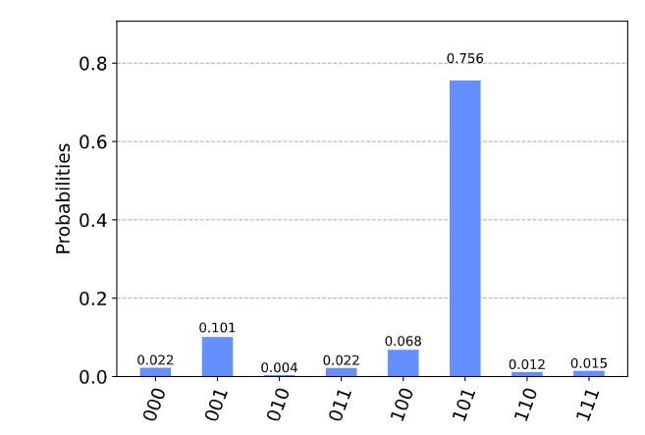
Read out the phases

Slide 18
3. Quantum Phase Estimation

Slide 19
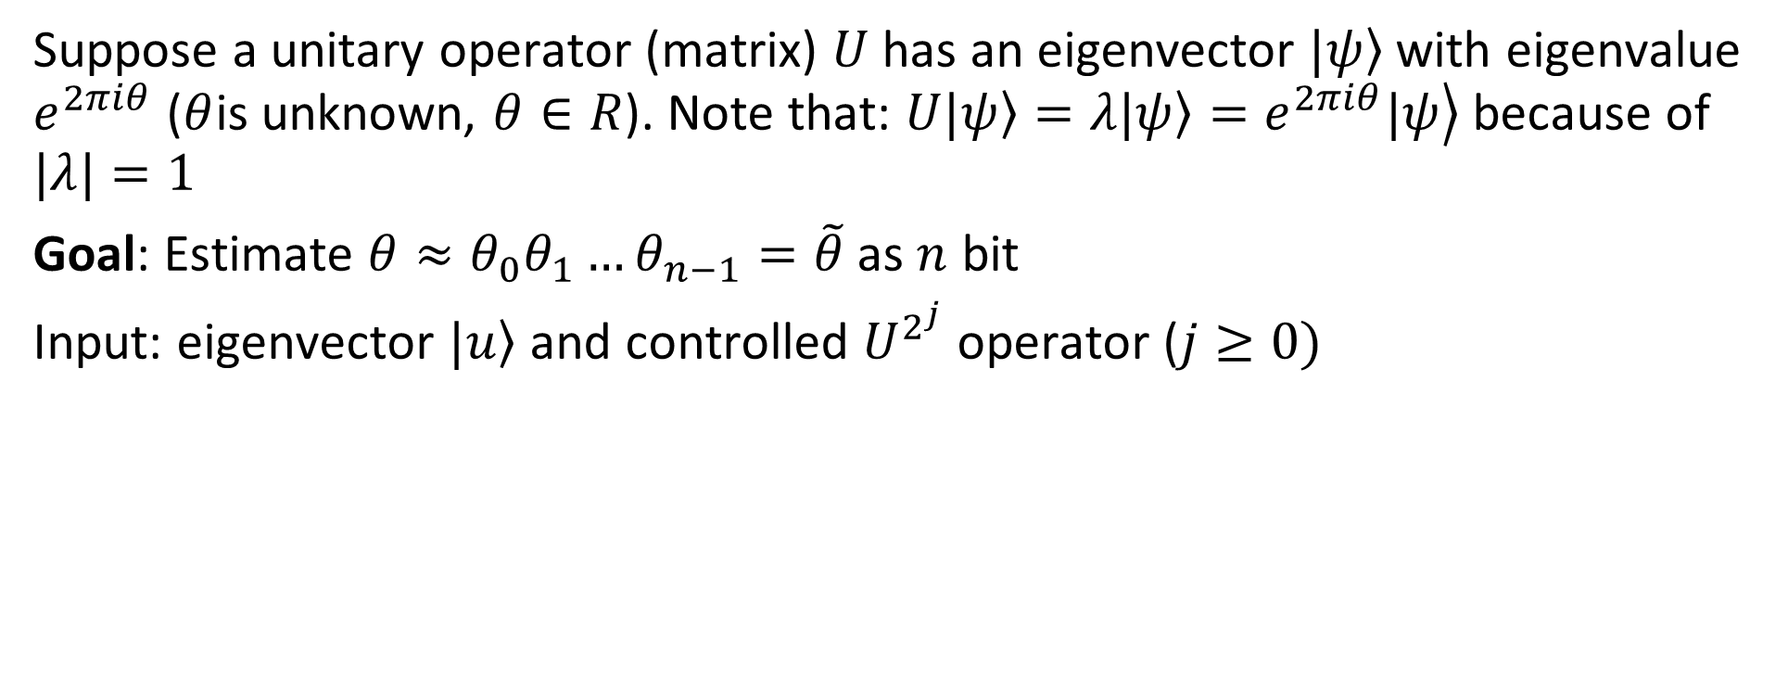
Suppose a unitary operator (matrix) $U$ has an eigenvector $\left.|ψ\right\rangle$ with eigenvalue $e^{2πiθ}$ ($θ$is unknown, $θ∈R$). Note that: $U\left.|ψ\right\rangle =λ\left.|ψ\right\rangle =\left.e^{2πiθ}|ψ\right\rangle$ because of $|λ|=1$
Goal: Estimate $θ≈θ_{0}θ_{1}…θ_{n−1}=\tilde{θ}$ as $n$ bit
Input: eigenvector $\left.|u\right\rangle$ and controlled $U^{2^{j}}$ operator ($j≥0)$

Slide 20
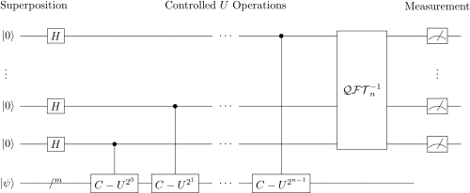
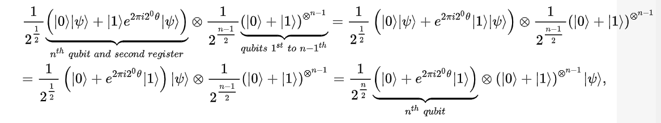
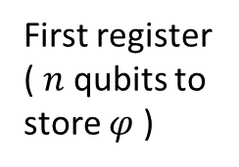
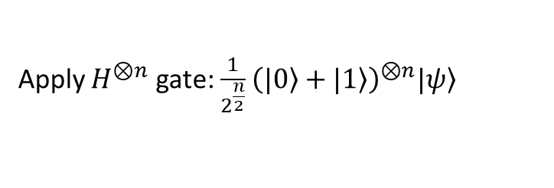
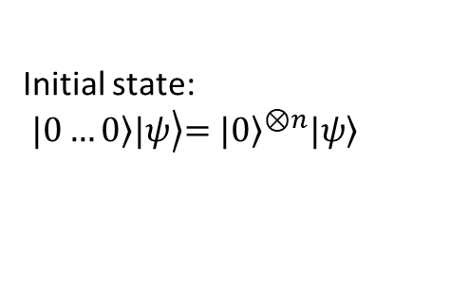
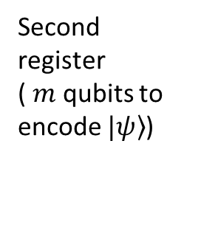
Initial state:
$$\left.\left.|0…0\right\rangle |ψ\right\rangle {\left.=|0\right\rangle }^{⊗n}\left.|ψ\right\rangle$$
First register
( $n$ qubits to store $φ$ )
Second register
( $m$ qubits to encode $\left.|ψ\right\rangle$)
Apply $H^{⊗n}$ gate:$\frac{1}{2^{\frac{n}{2}}}{\left(\left.|0\right\rangle +\left.|1\right\rangle \right)}^{⊗n}\left.|ψ\right\rangle$
Apply controlled unitary operations

Slide 21
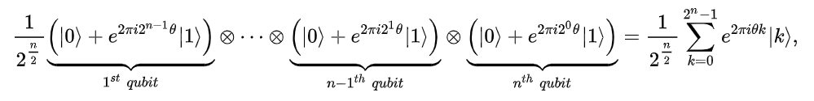
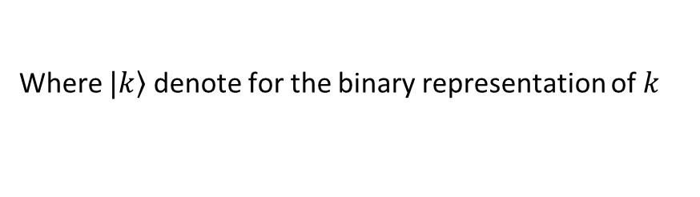
Initial state:
$$\left.\left.|0…0\right\rangle |ψ\right\rangle {\left.=|0\right\rangle }^{⊗n}\left.|ψ\right\rangle$$
First register
( $n$ qubits to store $φ$ )
Second register
( $m$ qubits to encode $\left.|ψ\right\rangle$)
Apply controlled unitary operations
Where $\left.|k\right\rangle$ denote for the binary representation of $k$

Slide 22
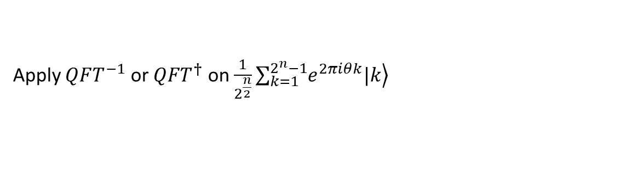
Initial state:
$$\left.\left.|0…0\right\rangle |ψ\right\rangle {\left.=|0\right\rangle }^{⊗n}\left.|ψ\right\rangle$$
First register
( $n$ qubits to store $φ$ )
Second register
( $m$ qubits to encode $\left.|ψ\right\rangle$)
Apply $QFT^{−1}$ or $QFT^{†}$ on $\frac{1}{2^{\frac{n}{2}}}\sum_{k=1}^{2^{n}−1}{\left.e^{2πiθk}|k\right\rangle }$
Yields:

Slide 23
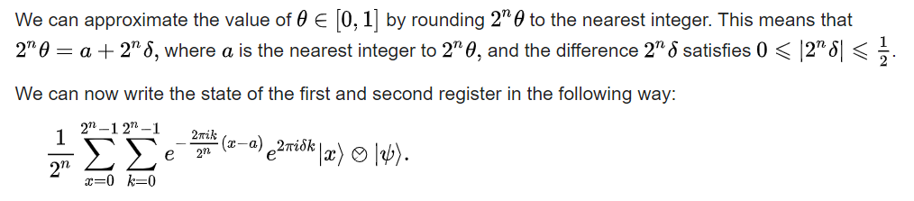
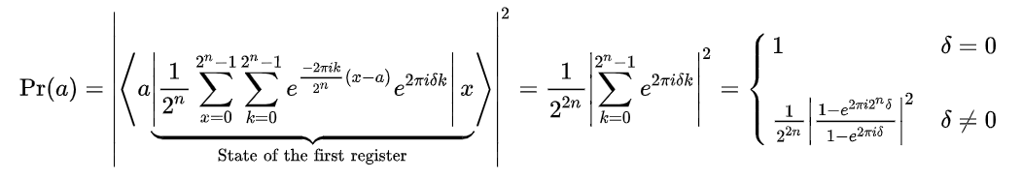

Slide 24
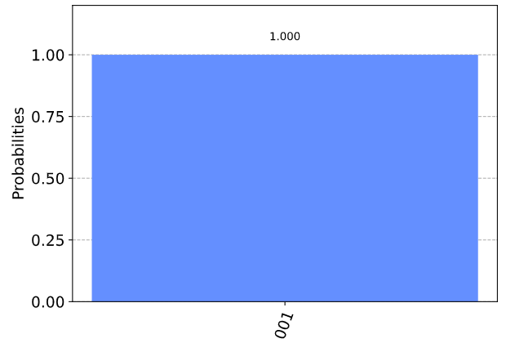
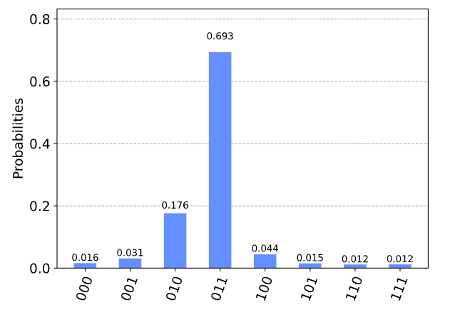

When $θ=\frac{{001}_{2}}{2^{n}}=1/8$
we see our most likely results are 010(bin) = 2(dec) and 011(bin) = 3(dec). These two results would tell us that θ = 0.25 (off by 25%) and θ = 0.375 (off by 13%) respectively

Slide 25
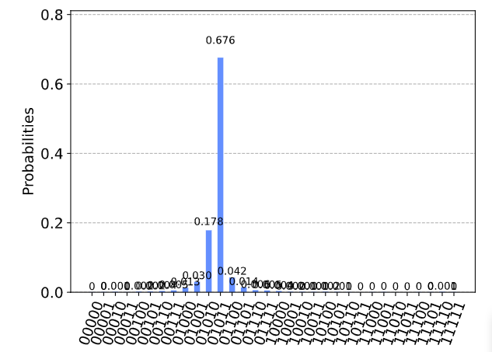

The two most likely measurements are now 01011 (decimal 11) and 01010 (decimal 10). Measuring these results would tell us $θ$ is:
$θ=\frac{11}{2^{5}}=0.344,θ=\frac{10}{2^{5}}=0.3$13

Slide 26

Questions
1. What ancilla qubits used for?
Store output
Padding for higher order gate with use less component than normal

Slide 27
Questions
How many iterations needed?
Common time?
The relationship between size of input (n) and number of qubits

